Slide 1
Creating a Landing Page with HTML
Presented by Joy Karani

Slide 2
agenda
INTRODUCTION 3
HTML BASICS 4
CSS BASICS 7
BUILDING A LANDING PAGE 6
Q&A SESSION 11

Slide 3
What is a Landing Page?
A landing page is a standalone web page created specifically for a marketing or advertising campaign.
It’s where a visitor "lands" after they click on a link in an email, or ads from Google, YouTube, Facebook, Instagram, Twitter, or similar places on the web.

Slide 4
Introduction to HTML
HTML stands for Hypertext Markup Language
It’s the standard markup language for creating web pages and describes the structure of a web page
It consists of a series of elements that tell the browser how to display the content
HTML elements label pieces of content such as "this is a heading", "this is a paragraph", "this is a link", etc

Slide 5
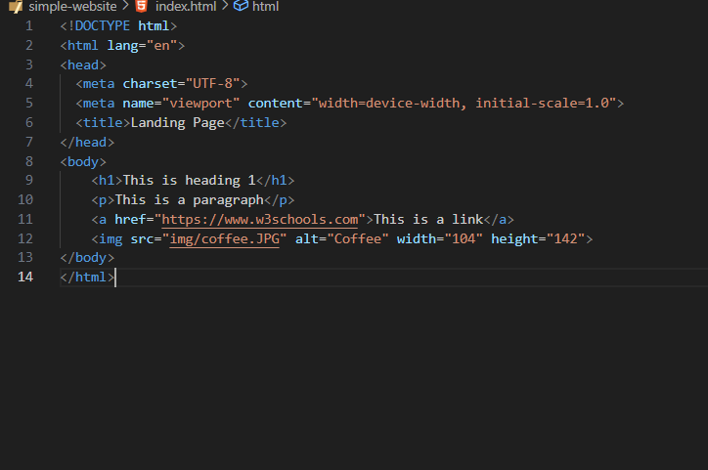
Basic HTML Structure

Slide 6
HTML Structure and Tags
<!DOCTYPE html> - defines the document type and HTML version
<html> - root element of an HTML page
<head> - contains metadata and <title>.
<body> - contains the content of the document.
main sections: <header>, <main>, <footer>.
Common Tags: <h1>, <p>, <a>, <img>

Slide 7
Introduction to CSS
CSS stands for Cascading Style Sheets
It lets you style your HTML pages.
It describes how HTML elements are to be displayed on screen, paper, or in other media.
CSS saves a lot of work as it can control the layout of multiple web pages all at once.

Slide 8
CSS Basics
CSS rules are made up of selectors and declaration blocks.
The selector points to the HTML element you want to style i.e. Element, Class, ID
The declaration block contains one or more declarations separated by semicolons.
Each declaration has a CSS Syntax: Selector, Property, Value.
Example: h1 { color: blue; }

Slide 9
Applying CSS to HTML
Inline CSS: Styles are applied directly within the HTML element using the style attribute.
Internal CSS: Styles are defined within the <style> tag in the <head> section of the HTML document.
External CSS: Styles are defined in an external .css file, which is linked to the HTML document using the <link> tag.

Slide 10

Live Coding Session
Open your text editor.
Write a basic HTML document.
Save with a .html extension and open it in a web browser.
Apply HTML and CSS concepts learned.

Slide 11
Q&A, final tips & takeaways
further LEARNING
W3Schools - Beginner-friendly site with tutorials, references, and examples for HTML, CSS, and more.
freeCodeCamp - Offers a full curriculum on web development, including HTML and CSS, with interactive coding challenges and projects
MDN Web Docs - Provides comprehensive and up-to-date documentation and tutorials on HTML, CSS, JavaScript, and other web technologies.

Slide 12

thank you

